Slide 1

APP MOBILE MUSIC Name: Lê Minh Khai

Slide 2
I. INTRODUCING:
Nowadays, almost all of them have cell phones and listening to music on the phone is very popular everywhere. So there's a need for a portable music player that is easy to operate and provides a good user experience.

Slide 3
App Mobile Music is app listen to music online or offline on mobile phones. Allow users to stream music or download music files over the internet a Wifi connection or 3G cell phone connection.

Slide 4
II. OVERVIEW
Research goals:
Create an application and perform its functions.
This app will automatically collect information about the user's music habits and then list the music that best suits the user.

Slide 5
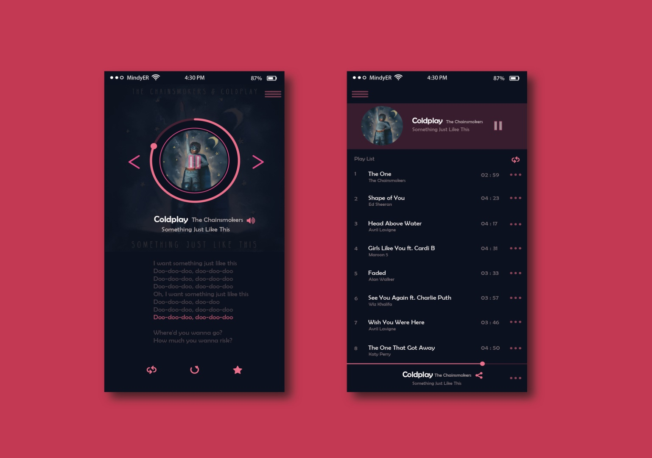
User Interface:

Slide 6
Thanks for your listening

